Slide 1




Microservices & Apache Kafka for open, decoupled, scalable interaction and collaboration
Synergy with independence
Lucas Jellema, CTO of AMIS
August 2018

Slide 2
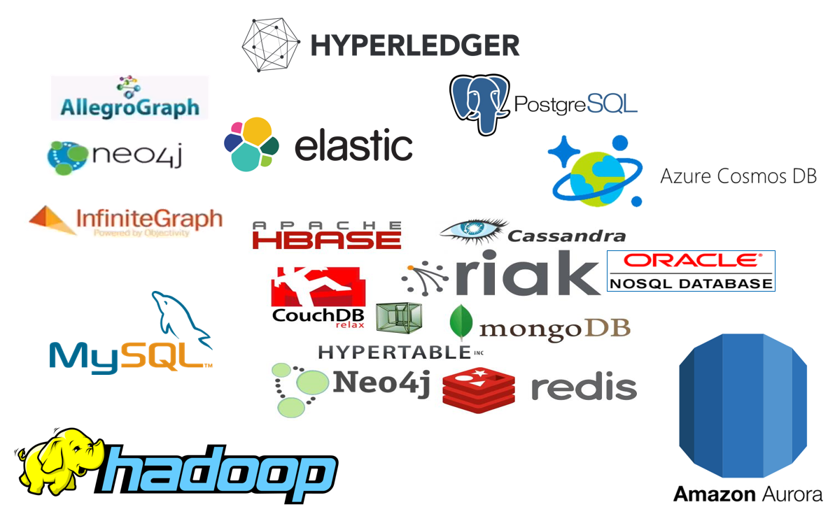




What is Apache Kafka & Why is it Important?
The Event Fabric bringing IT together
µ
µ
Notes:
Fast data arrives in real time and potentially high volume. Rapid processing, filtering and aggregation is required to ensure timely reaction and actual information in user interfaces. Doing so is a challenge, make this happen in a scalable and reliable fashion is even more interesting. This session introduces Apache Kafka as the scalable event bus that takes care of the events as they flow in and Kafka Streams and KSQL for the streaming analytics. Both Java and Node applications are demonstrated that interact with Kafka and leverage Server Sent Events and WebSocket channels to update the Web UI in real time. User activity performed by the audience in the Web UI is processed by the Kafka powered back end and results in live updates on all clients.
Fast data arrives in real time and potentially high volume. Rapid processing, filtering and aggregation is required to ensure timely reaction and actual information in user interfaces. Doing so is a challenge, make this happen in a scalable and reliable fashion is even more interesting. This session introduces Apache Kafka as the scalable event bus that takes care of the events as they flow in and Kafka Streams for the streaming analytics. Both Java and Node applications are demonstrated that interact with Kafka and leverage Server Sent Events and WebSocket channels to update the Web UI in real time. User activity performed by the audience in the Web UI is processed by the Kafka powered back end and results in live updates on all clients. Introducing the challenge: fast data, scalable and decoupled event handling, streaming analytics Introduction of Kafka demo of Producing to and consuming from Kafka in Java and Nodejs clients Intro Kafka Stream API for streaming analytics Demo streaming analytics from java client Intro of web ui: HTML 5, WebSocket channel and SSE listener Demo of Push from server to Web UI - in general End to end flow: - IFTTT picks up Tweets and pushed them to an API that hands them to Kafka Topic. - The Java application Consumes these events, performs Streaming Analytics (grouped by hashtag and author and time window) and counts them; the aggregation results are produced to Kafka - The NodeJS application consumes these aggregation results and pushes them to Web UI - The WebUI displays the selected Tweets along with the aggregation results - in the Web UI, users can LIKE and RATE the tweets; each like or rating is sent to the server and produced to Kafka; these events are processed too through Stream Analytics and result in updated Like counts and Average Rating results; these are then pushed to all clients; this means that the audience can Tweet, see the tweet appear in the web ui on their own device, rate & like and see the ratings and like count update in real time

Slide 3


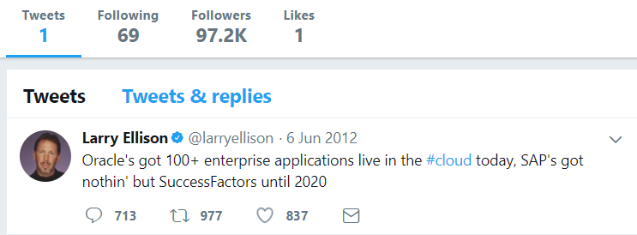
Heck, I do not even know these people and they may not know me [personally] – just my pearls of wisdom. And if they are late to the party, they can also check out the historic archives of my eloquence
Without fretting about the numbers of readers involved and whether they are in the same time zone as me and online when I publish my messages – and which device they use
It would be so nice if I could publish my ideas and actions, accessible near instantly for everyone who is interested

Slide 4

Heck, I do not even know these people and they may not know me [personally] – just my pearls of wisdom. And if they are late to the party, they can also check out the historic archives of my eloquence
Without fretting about the numbers of readers involved and whether they are in the same timezone as me and online when I publish my messages – and which device they use
It would be so nice if I could publish my ideas and actions, accessible near instantly for everyone who is interested

Slide 5

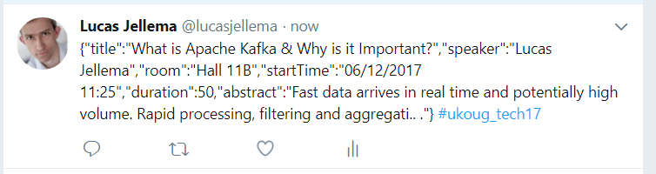
Decoupled communication
0, 1 or many followers
Scalable number of messages (and parties)
Reliable (mostly available, few messages lost)
Full history
Open: cross device, cross location
Not Sub-second, near real-time fast
Rate limited (#messages/minute)
Size limited (140-280 characters)
Format limited (text)
Not for private interactions
Not (really) for programmatic use

Slide 6
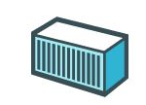
Oracle Database
DVX_ORDERS
Oracle Database
ORDERS

Slide 7
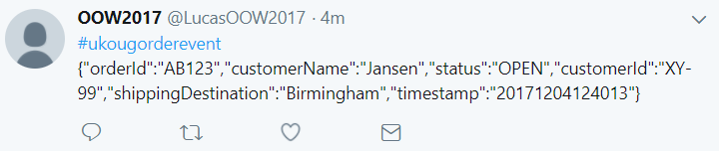
Oracle Database
DVX_ORDERS
DML
Oracle Database
ORDERS

Slide 8

µ
Oracle Database
DVX_ORDERS
Oracle Application Container Cloud
Oracle DBaaS Cloud
DML
In the Cloud
On premises
Oracle Database
ORDERS
µ
Locally running Node application

Slide 9
What does the Twitter for System Driven Event Interaction look like?
Decoupled communication – organized per topic
0, 1 or many Consumers per Topic
Scalable number of messages (and parties)
Reliable (distributed)
Full history
Open: libraries in many technologie & REST APIs

Slide 10
µ
Oracle Database
DVX_ORDERS
Oracle Application Container Cloud
Oracle DBaaS Cloud
Oracle Event Hub
DML
In the Cloud
On premises
Oracle Database
ORDERS
µ
Locally running Node application

Slide 11
What does the Twitter for System Driven Event Interaction look like?
Decoupled communication – organized per topic
0, 1 or many Consumers per Topic
Scalable number of messages (and parties)
Reliable (distributed)
Full history
Open: libraries in many technologie & REST APIs
Near real-time fast
No Rate Limit
No enforced size limit
Anything goes (it’s all byte[])
On premises or in cloud, private or trusted
Very much for programmatic use

Slide 12
Events
Consumers
Producers
Robust, Scalable, Fast, History Retention
Containerized/Cloud-enabled
Open

Slide 13
Messaging as we know it
JMS, Oracle Advanced Queuing, IBM MQ, MS MQ, RabbitMQ, MQTT, XMPP, WebSockets, Oracle Coherence, …
Challenges
Costs
Scalability (size and speed)
(lack of) Distribution (and therefore availability)
Complexity of infrastructure
Message delivery guarantees
Lack of technology openness
Deal with temporarily offline consumers
Retain history

Slide 14
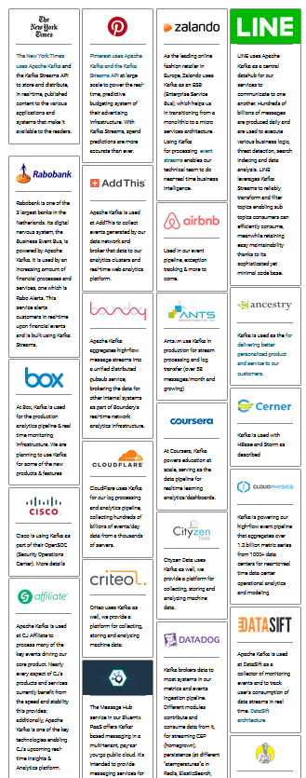

Introducing Apache Kafka
..- 2010 – creation at Linkedin
Message Bus | Event Broker
High volume, low latency, highly reliable, cross technology
Scalable, distributed, strict message ordering, ….
2011/2012 – open source under the Apache Incubator/ Top Project
Kafka is used by many large corporations:
Walmart, Cisco, Netflix, PayPal, LinkedIn, eBay, Spotify, Uber, Sift Science, Zalando, The New York Times, Airbnb, Coursera, ING Bank,…
And embraced by many software vendors & cloud providers
Client libraries available for Node, Java, C/C++, Python, Ruby, PHP, Go, Rust, .NET, Perl, Scala DSL, Clojure, Swift and more

Slide 15
Kafka terminology
Message
Topic
Message
== ByteArray
Broker
Producer
Consumer
Key
Value
Time
Producer
Consumer
Broker
Topic

Slide 16
Key
Value
Time
Consumers
Producers
Broker
Topic

Slide 17
Consuming
Messages are available to consumers only when they have been committed
Kafka does not push
Unlike JMS
Read does not destroy
Unlike JMS Topic
(some) History available
Offline consumers can catch up
Consumers can re-consume from the past
Delivery Guarantees
Ordering maintained
At-least-once (per consumer) by default; at-most-once and exactly-once can be implemented

Slide 18
Key
Value
Time
Consumers
Producers
Broker
Topic

Slide 19


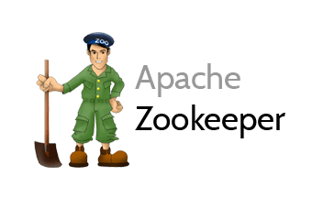
Consumers
tcp
Producers
tcp
Broker
Topic

Slide 20
What’s so special?
Durable
Scalable
High volume
High speed
Available
Distributed
Open
Quick start
Free (no license costs)
Connectors, Streaming, KSQL
“Self Fulfilling Prophecy” (positive feedback loop)

Slide 21
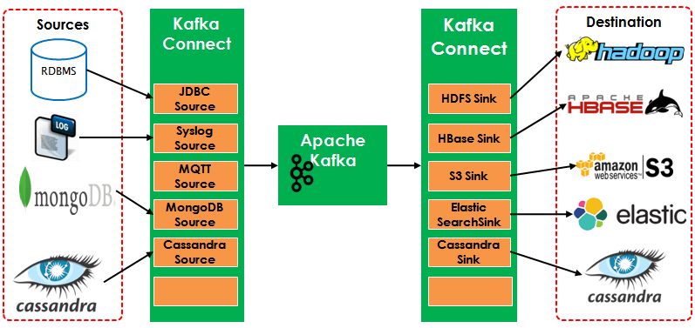
Kafka Connectors
Adapters for reading data from and writing data to many platforms
Notes:
https://www.confluent.io/connectors/
https://www.confluent.io/hub/

Slide 22

How do we implement microservices?
And how we make the containers horizontally scalable
How do we get from a Monolith to Microservices?

Slide 23
Why? What? How?
Notes:
Objectives
Requirements
Specifications

Slide 24
What is IT all about?
Production Runtime
Application

Slide 25
What is IT all about?
Production Runtime
Application
Platform

Slide 26
Objectives
Business Agility
In functionality: quick, cheap, effortless and risk free
IT Agility
In non-functionality: scale, resilience, infrastructure & location
Real working applications with rapid relevant evolution that run reliably

Slide 27
What is IT all about?
Production Runtime
Operations
Monitoring & Management
Application
Platform
Platform
Platform

Slide 28
Production Runtime is the Result of Preparation Runtime
Preparation Runtime
Production Runtime
Development
Operations
Monitoring & Management
Application
Application
Agile Design, Build, Test
Platform
Platform
CD

Slide 29
What?

Slide 30
One team has Agile responsibility through full lifecyle
Preparation Runtime
Production Runtime
Development
Operations
Monitoring & Management
Application
Application
Agile Design, Build, Test
Platform
Platform
CD

Slide 31
One team has Agile responsibility through full lifecyle
Preparation Runtime
Production Runtime
DevOps
Development
Operations
Monitoring & Management
Application
Application
Agile Design, Build, Test
Platform
Platform
CD
You build it, you run it, you fix it, you evolve

Slide 32
One team has Agile responsibility through full lifecyle
DevOps
Application
Application
Platform
Platform
You build it, you run it, you fix it, you evolve

Slide 33
DevOps team owns and runs one (or more) products
Application
Platform
Generic Infrastructure Platform for running DevOps Products
Floorspace, Power, Cooling, Storage, Compute
Monitoring, Management, Cache, Authentication, RDBMS, Event Hub

Slide 34
Multiple products from multiple teams run on a shared generic infrastructure
Application
Application
Application
Application
Application
Platform
Platform
Platform
Platform
Platform
Generic Infrastructure Platform for running DevOps Products
Floorspace, Power, Cooling, Storage, Compute
Monitoring, Management, Cache, Authentication, RDBMS, Event Hub

Slide 35
(Application plus platform)under DevOps ==
µ
µ
µ
µ
µ
Generic Infrastructure Platform for running DevOps Products
Microservice

Slide 36
What?
Realistic approach (technology, people, process) => Something that works!
No dependency on individuals
Able to scale in rate of change
Small, well: comprehensible, manageable
Stand alone /isolated/encapsulated (in terms of change, release/deploy, scale, location, implementation technology)
Provide clear and meaningful functionality in a way that it can be consumed
One microservice does not completely fall over when other microservices break (or are redeployed)
Able to scale elastically & horizontally and relocate easily

Slide 37
How?

Slide 38
How microservices
One team owns the microservice and can do functional and technical evolution and deployment continuously and independently
The business ownership is clearly defined
Application
Platform

Slide 39
The Microservice
HTTP REST/JSON
API

Slide 40
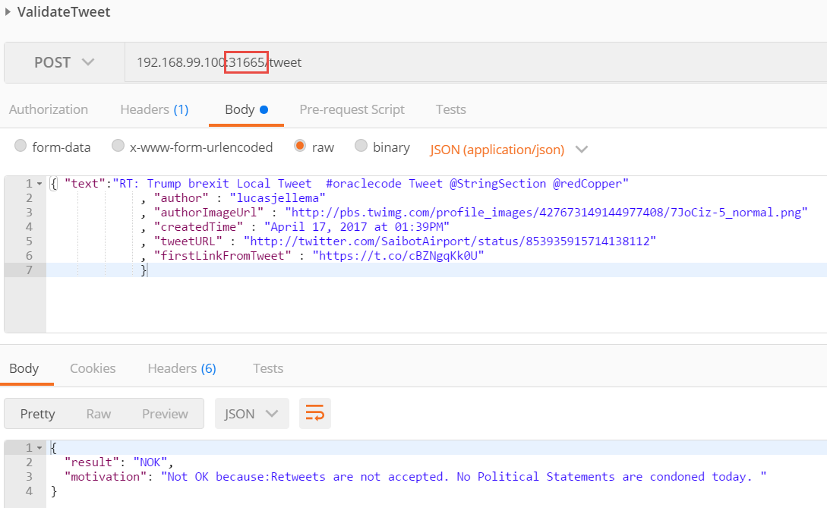
The Microservice: Validate Tweet
HTTP REST/JSON
API

Slide 41
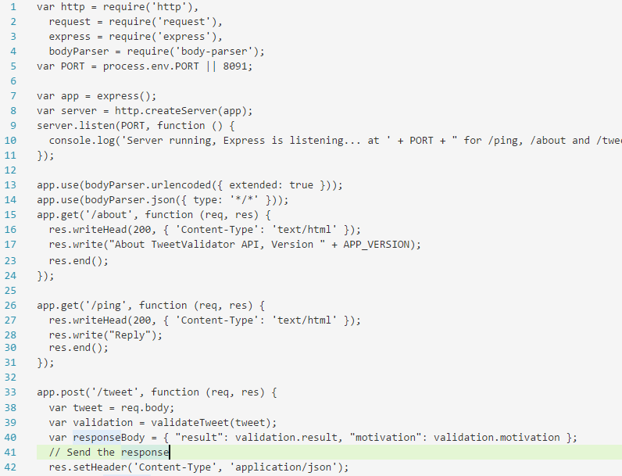
Microservice business functionality: Tweet Validation

Slide 42
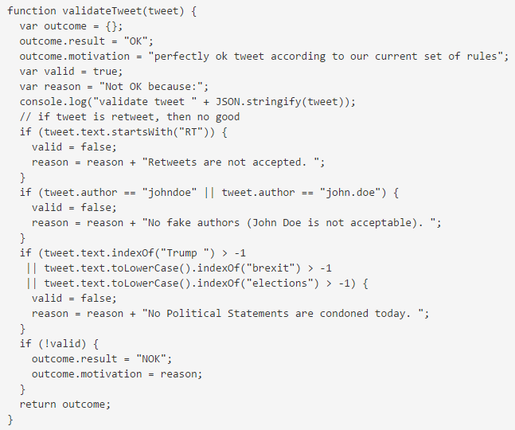
Microservice business functionality: Tweet Validation

Slide 43

How microservices: design & implement
Business & Team ownership of application and associated platform
Automated CD – including regression test
Open (standards, protocols) on the outside, whatever you like inside
Deployable on enterprise standardized microservices platform
API & Event
Standard protocols for interaction
Horizontally scalable: multiple parallel instances
Stateless instances – horizontally scalable up & down, can handle fail over & restart
Private Bounded (Data) Context
Including derived data from other domains

Slide 44

Microservices State
Generic Platform for running microservices
LDAP
Big Data
Block Storage
Cache
RDBMS
NoSQL
Document Store
Event Hub
Notes:
All data stores are distributed
Or at least distributedly available
They can be local or on cloud (latency is important)
Data in generic data store is still owned by only one microservice – no one can touch it
Only in DWH and BigData do we deliberately take copies of data and disown them

Slide 45
Bounded context in microservices
A micoservice needs to be able to run independently
It needs to contain & own all data required to run
It cannot depend on other microservices
UI
API
Customer
API
Order
CustomerModified event

Slide 46







Demo – Maintaining Derived Data in Bounded Context
Customer Microservice
Order Microservice
Customer Modified Event
Application Container
Application Container
Event Hub
Customers
Topic
DBaaS

Slide 47
Microservices based Webshop
Web Shop Portal
µ Customers
µ Orders
µ Products
µ Loyalty
µ Finance
µ Logistics
µ Customers
µ Orders
µ Products
µ Loyalty
µ Finance
Notes:
dazzle the audience with a quick dump of all technologies (and cloud services) used for putting the webshop together - for the UI, the API implementation, the datastores and the event bus.

Slide 48




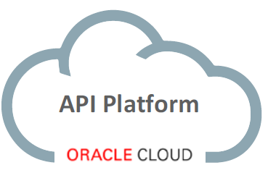



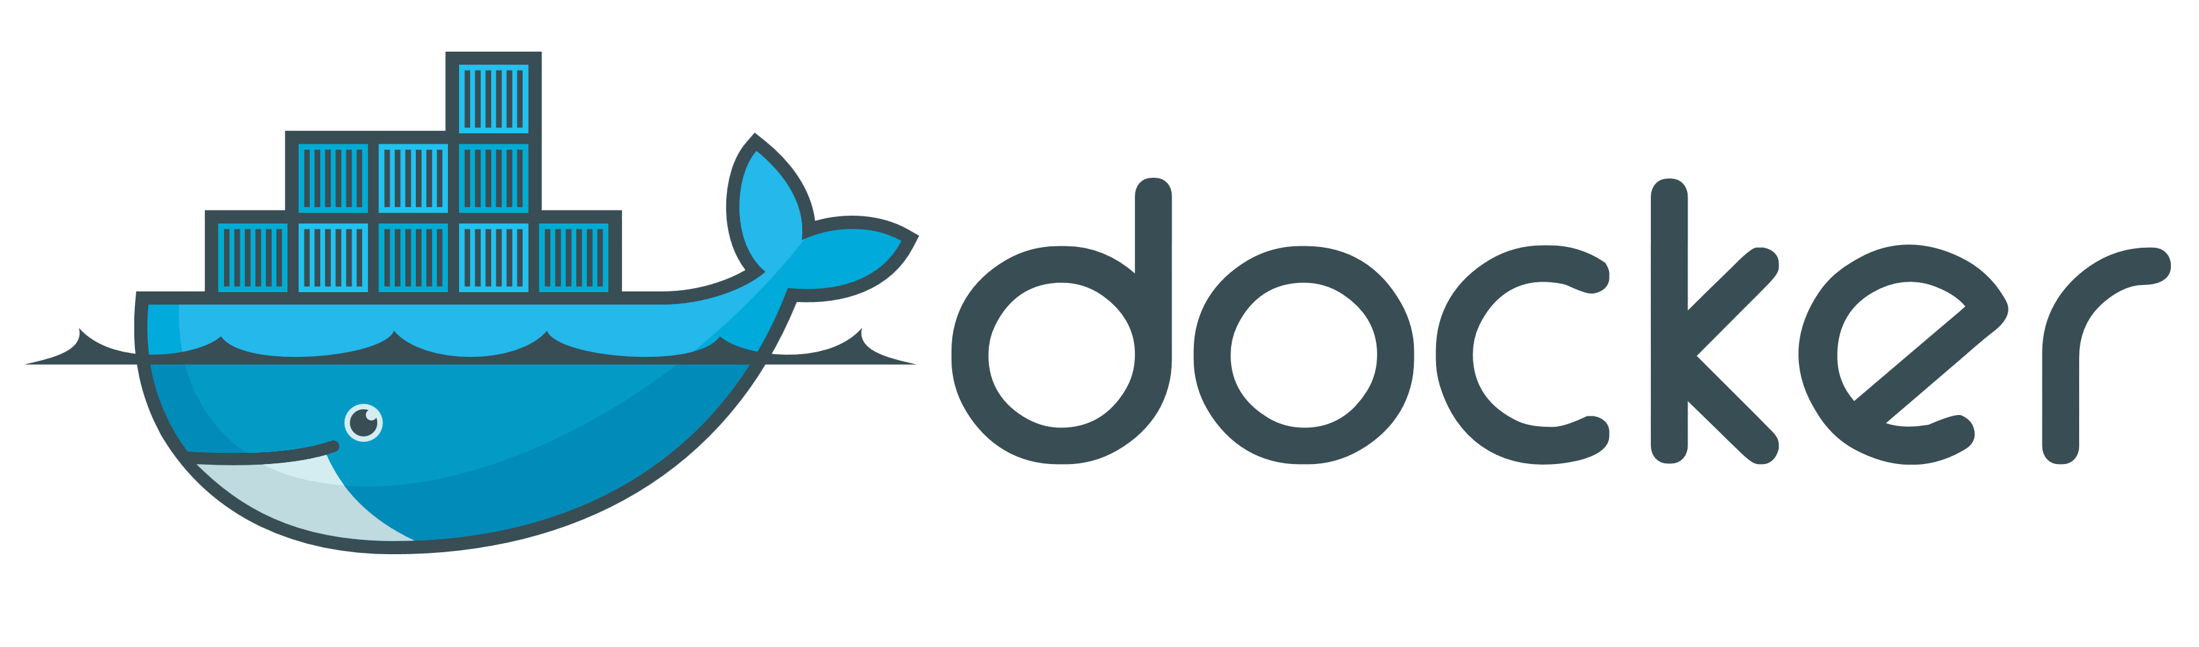
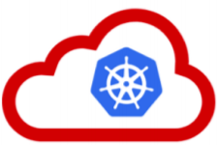










API Portal
Web Shop Portal
µ Customers
µ Orders
µ Products
µ Loyalty
µ Finance
API Platform
Backoffice UI
λ
Event Schema Registry
Event Hub
Notes:
dazzle the audience with a quick dump of all technologies (and cloud services) used for putting the webshop together - for the UI, the API implementation, the datastores and the event bus.

Slide 49

…. Event-(First) Driven
Event Monitor
Product Update
Product added to Shopping Cart
Shop
Products
Event Hub
Topic X
Topic Y
Topic Z
Topic Q
New Customer
Customer Profile Changed
Customer Sign In
Customers
Order Payment Received
Customer Frozen
Customer Loyalty Status Change
Order Create
Order Canceled
Product Stock Update
Shipping News
Loyalty Program
Order
Logistics
Finance

Slide 50
Microservices platform
API Gateway
Authenticate
API
API
API
Receives microservice deployment
Handles scale out & fail over
Start/stop microservice instances based on non functional requirements and live observed behavior
Supports automated DevOps
CD, monitoring, throttling, circuit breaker, auditing, …
Provides Capabilities – generic facilities available to microservices from the run time platform
Provided through public APIs whenever possible
Injected meta-data at run time
implemented by generic/platform level microservices
Logging
Cache
Microservices Platform
deploy, inject dependencies, start, watch, restart, stop, scale

Slide 51
Shared platform capability
Microservices are isolated
Not aware of each other (except through public APIs)
Not sharing private resources
Ideally each microservice brings its own platform
To prevent run time environment from being out of synch and creating dependency/impact between multiple platform users
However: At some level, sharing is inevitable: Storage, Compute, power supply, building
In practice: having full blown RDBMS or Java EE server or Kafka cluster as part of a microservice may be unfeasible
Even if Docker images are light weight from layering – the run time resource usage is probably not – and there could be an issue with software licenses
Provide generic ‘heavy duty’ platform capabilities, available for use in any microservice in a standardized way

Slide 52
Microservices cross platform capabilities
Authentication
Persistent Storage
Cache
Load balancing/API Gateway
Service Discovery/Lookup
Monitoring
Functional/Business KPIs
Non Functional Platform/Container & Infra
Audit, Usage tracking, Billing
Notifications and alerting
Logging
Relational Database Capability
Usage Tracking
API
UI
Notification
UI
API
API
Authentication
Logging
Microservices Platform
Cache

Slide 53
Example system architecture
API
API
NodeJS & Express
REST/JSON
REST/JSON
Widgets
HTML 5 Web Component
Usage Tracking
UI
API
REST/JSON
API
UI
Notification
API
UI
Authentication
API
Legacy Application
Logging
Python & MySQL
Java / Spring Boot
NodeJS & Express & MongoDB
Strangler
Cache
WebLogic & Oracle Database
Redis
Microservices Platform
Storage
Notes:
https://www.martinfowler.com/bliki/StranglerApplication.html
https://dzone.com/articles/why-springboot

Slide 54
Trends, challenges, common
Use of containers and container management
Docker Containers – layered, packaged & shippable, registry
Docker Container Management: Composer, Mesos, Swarm or Kubernetes
Application Container platform such as Google App Engine, Azure App Service, Oracle Application Container Cloud, AWS Beanstalk
Serverless computing – AWS Lambda, Oracle Fn, Azure Functions
Use of cache for [state of] longer running conversations
Transaction, session, workflow, business process
New ways to consider data
Every microservice owns the data it requires – data denormalization and duplication of data across microservices is a logical consequence
Command Query Responsibility Segregation (CQRS) and Event Sourcing
Orchestration | Choreography across microservices

Slide 55
Events
Consumers
Producers

Slide 56
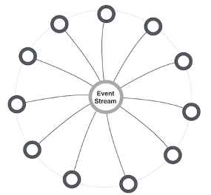
MicroServices and events
Report business events [without knowing to whom and without expecting a response]
Allowing interested microservices to respond – for example trigger serverless functions
Provide response to stateless caller – with conversation key
Choreograph cross-microservice workflow | process
Inform workflow | process orchestrator | job scheduler about activity status
Enable distributed transaction – commit and rollback/compensate
Make data events available for event sourcing
Allowing microservices to maintain their own [derived] data set
Synchronize cache refresh
Informing any microservice caching data about the need to refresh specific records
Hand systems events & metrics to monitoring service
Extreme decoupling – microservice choreography
Microservice never call each other, not even through public API; all interactions are through events
Notes:
http://microservices.io/patterns/data/event-driven-architecture.html
http://eventuate.io/whyeventdriven.html
http://www.kennybastani.com/2017/01/building-event-driven-microservices.html

Slide 57
Requirements for Event capability in microservices platform
Provide decoupling between publisher and consumer
Generally accessible for all microservices
Across the platform
Using standardized protocols and formats for communications and event payload (http, JSON)
Scalable (handle high loads)
Available (allow speedy event publication)
Reliable (do not lose events, at least once delivery)
Event Ordering (deliver events in the order of publication)
Allow multiple, parallel consumers (each event to exactly only one of them)
Retain Event History
Event Catalog – which events are published, what do they mean and what is their payload
Harvested from microservices

Slide 58
Extended API of microservice
API
Deployment API
Injectable dependencies – reference to cache, logging, storage URL, …
Configurable meta-data – run time parameters, log level, credential (key)
Interaction API
REST Resources & Operations – query and URL parameters, message formats
Events Consumed – alternative way to call | activate a microservice
Reference to entry in Event Catalog
May include reference to shared Cache Resource
Events Produced – alternative output from microservice
Event can be an asynchronous response to a stateless consumer

Slide 59
Microservice Choreography

Slide 60
Requirements on workflow
Management information on running instances and their state
Recover or fully rollback functionally failed process instances
No stuck process instances: an instance that is no longer being processed
either because of a failed or a lacking actor
No race conditions – multiple action working on the same instance should not interfere when updating state
New workflow definitions can be created without impacting running instances or changing existing microservices
New or updated actors – a microservice that can execute a step in a workflow – can be introduced without impacting other components
In general: ideally, the workflow and its constituent actors are decoupled – communication is not synchronous nor direct

Slide 61
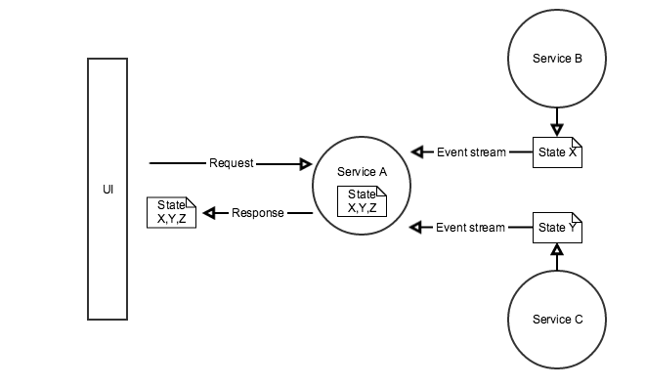
Microservice Workflow execution
Multi step process
Long running, with state, happy & non-happy
Changes in workflow definition & state structure
Each step (potentially) in different microservice
Microservices are unaware of each other
Multiple approaches
Orchestrator – running the process by invoking the required microservices subsequently, responding either to synch response, asynch callback or event
Choreography – allow the required microservices to react to relevant events
Act when it is your turn (as determined by routing slip?)
Share state through cache with claim check in routing slip
When done, publish updated routing slip
Possibly implement compensation handler
Notes:
http://www.dreweaster.com/blog/2016/05/08/the-art-of-microservices-integration-using-service-choreography/
End-to-end autonomy (each microservice leverages event sourcing to maintain the state it needs (even though it does not own it)
https://www.slideshare.net/CAinc/hypermediadriven-orchestration-in-microservices-55985377

Slide 62


Cross Microservices Workflow
Choreography vs Orchestration – Which one is which?

Slide 63

Desired Workflow
done
Tweet about <some topic>
Validate Tweet
No simple retweet, no black listed words used, no known robot tweeter or otherwise excluded authors, no undesirable location
Enrich Tweet
Add Tweet to TweetBoard
Publish TweetBoard
Details about author, location, hashtags, acronyms and abbreviations used in tweet
Add the tweet to the top of the TweetBoard – a list of recent, relevant tweets
Publish the TweetBoard through API and UI (HTML web document)

Slide 64
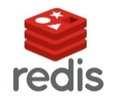
Microservices to map the workflow to
On premises
Tweet Receiver
TweetBoard
REST/JSON
Validate Tweet
REST/JSON
Enrich Tweet
API
API
API
UI
API
Cache
Java SE/ Node.js
Java SE
Event Bus
Microservices Platform
Notes:
Workflow initiator responds to NewTweetEvent
Workflow Initiator - When tweet is for hashtag oraclecode then create routingslip document with tweet data, store in cache under key and publish workflow event for OracleCodeTwitterWorkflow with cache key for workflow state in payload
Validate Tweet – when OracleCodeTwitterWorkflow event – fetch workflow state from cache based on event payload, check routingslip to see if ValidateTweet should act; if so, validate tweet, update routing slip, retrieve and store in cache; publish workflow event for OracleCodeTwitterWorkflow with cache key for workflow state in payload
Enrich Tweet – when OracleCodeTwitterWorkflow event – fetch workflow state from cache based on event payload, check routingslip to see if EnrichTweet should act; if so, enrich tweet, update routing slip, retrieve and store in cache; publish workflow event for OracleCodeTwitterWorkflow with cache key for workflow state in payload
TweetBoard – when OracleCodeTwitterWorkflow event – fetch workflow state from cache based on event payload, check routingslip to see if TweetBoard should act; if so, add tweet to tweet list, update routing slip, retrieve-and-store in cache; publish workflow event for OracleCodeTwitterWorkflow with cache key for workflow state in payload
All microservices publish logging about their actions with the conversation identifier as part of the logging

Slide 65
Choreographed workflow
On premises
Tweet Receiver
Workflow Launcher
TweetBoard
Event Bus
API
API
Validate Tweet
API
UI
API
Cache
Enrich Tweet
Microservices Platform
Notes:
Workflow initiator responds to NewTweetEvent
Workflow Initiator - When tweet is for hashtag oraclecode then create routingslip document with tweet data, store in cache under key and publish workflow event for OracleCodeTwitterWorkflow with cache key for workflow state in payload
Validate Tweet – when OracleCodeTwitterWorkflow event – fetch workflow state from cache based on event payload, check routingslip to see if ValidateTweet should act; if so, validate tweet, update routing slip, retrieve and store in cache; publish workflow event for OracleCodeTwitterWorkflow with cache key for workflow state in payload
Enrich Tweet – when OracleCodeTwitterWorkflow event – fetch workflow state from cache based on event payload, check routingslip to see if EnrichTweet should act; if so, enrich tweet, update routing slip, retrieve and store in cache; publish workflow event for OracleCodeTwitterWorkflow with cache key for workflow state in payload
TweetBoard – when OracleCodeTwitterWorkflow event – fetch workflow state from cache based on event payload, check routingslip to see if TweetBoard should act; if so, add tweet to tweet list, update routing slip, retrieve-and-store in cache; publish workflow event for OracleCodeTwitterWorkflow with cache key for workflow state in payload
All microservices publish logging about their actions with the conversation identifier as part of the logging

Slide 66
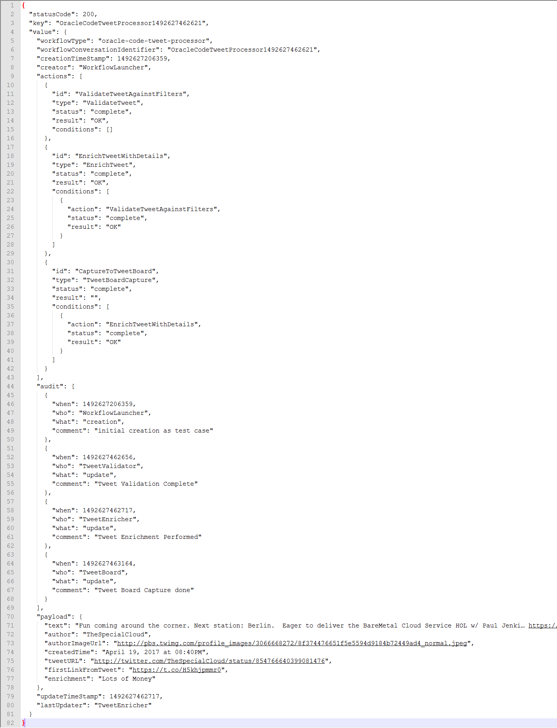
Routing Slip published by workflow Launcher
If NOK, then done
Validate Tweet
Enrich Tweet
Add Tweet to TweetBoard
Publish TweetBoard

Slide 67
Routing Slip for completed workflow

Slide 68
Choreographed workflow
On premises
Tweet Receiver
Workflow Launcher
TweetBoard
Event Bus
API
API
Validate Tweet
API
UI
API
Cache
Enrich Tweet
Microservices Platform
Notes:
Workflow initiator responds to NewTweetEvent
Workflow Initiator - When tweet is for hashtag oraclecode then create routingslip document with tweet data, store in cache under key and publish workflow event for OracleCodeTwitterWorkflow with cache key for workflow state in payload
Validate Tweet – when OracleCodeTwitterWorkflow event – fetch workflow state from cache based on event payload, check routingslip to see if ValidateTweet should act; if so, validate tweet, update routing slip, retrieve and store in cache; publish workflow event for OracleCodeTwitterWorkflow with cache key for workflow state in payload
Enrich Tweet – when OracleCodeTwitterWorkflow event – fetch workflow state from cache based on event payload, check routingslip to see if EnrichTweet should act; if so, enrich tweet, update routing slip, retrieve and store in cache; publish workflow event for OracleCodeTwitterWorkflow with cache key for workflow state in payload
TweetBoard – when OracleCodeTwitterWorkflow event – fetch workflow state from cache based on event payload, check routingslip to see if TweetBoard should act; if so, add tweet to tweet list, update routing slip, retrieve-and-store in cache; publish workflow event for OracleCodeTwitterWorkflow with cache key for workflow state in payload
All microservices publish logging about their actions with the conversation identifier as part of the logging

Slide 69
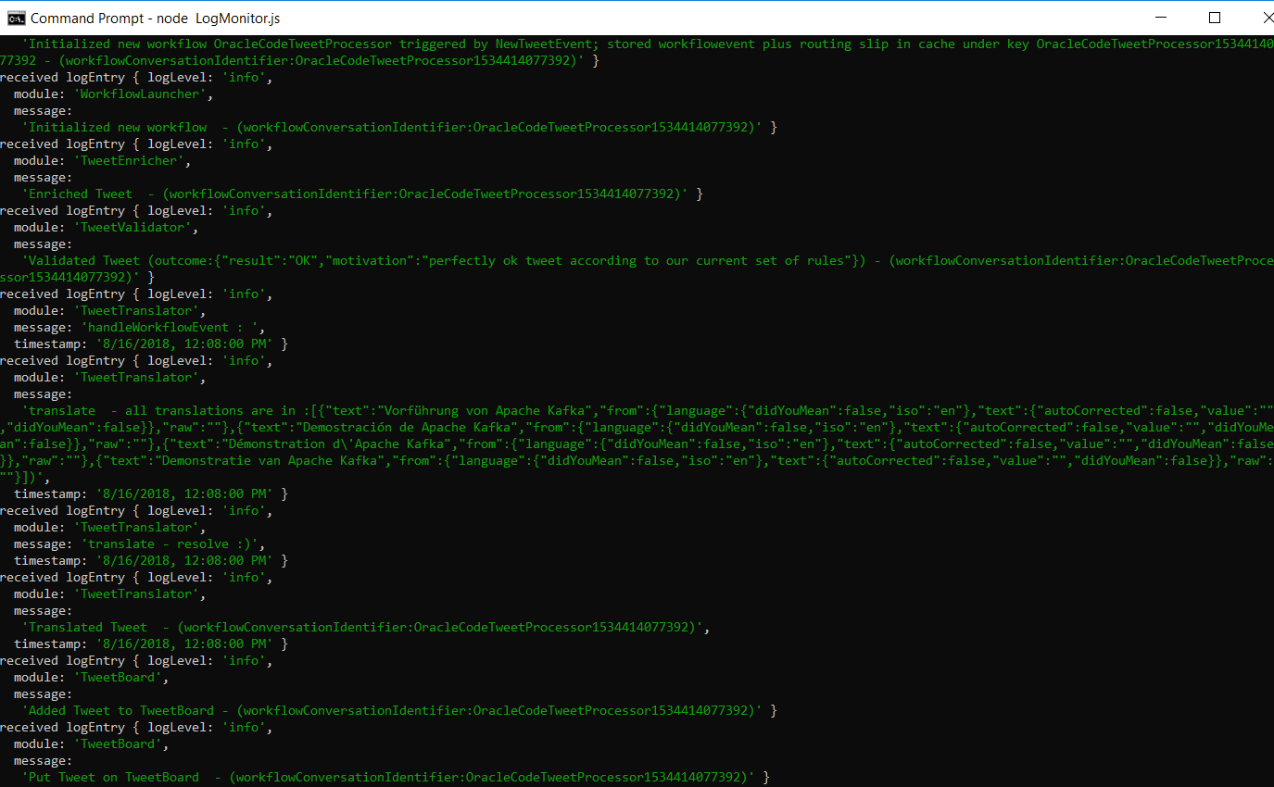
Logging
API
LogMonitor
Event Bus
Topic: logTopic
Tweet Receiver
Workflow Launcher
TweetBoard
Topic: workflowevents
API
API
Validate Tweet
API
UI
API
Cache
Enrich Tweet
Microservices Platform

Slide 70
Extending the workflow choreography – with translation of the tweet
If NOK, then done
Translate Tweet
Validate Tweet
Enrich Tweet
Add Tweet to TweetBoard
Publish TweetBoard

Slide 71
Extending the workflow choreography – with translation of the tweet
If NOK, then done
Implement microservice for
Translating tweets
Participating in Workflow
Deploy microservice - with access to Event Bus & Cache
Extend Workflow Template
Add new ‘translation’ step – dependency on Enrich Tweet
Change current ‘tweetboard’ step – modify dependency to Translation
Validate Tweet
Enrich Tweet
Translate Tweet
Add Tweet to TweetBoard
Publish TweetBoard

Slide 72
Choreographed workflow
On premises
Tweet Receiver
Workflow Launcher
TweetBoard
Event Bus
API
API
API
Validate Tweet
API
API
UI
API
Translate Tweet
Cache
Enrich Tweet
Microservices Platform
Notes:
Workflow initiator responds to NewTweetEvent
Workflow Initiator - When tweet is for hashtag oraclecode then create routingslip document with tweet data, store in cache under key and publish workflow event for OracleCodeTwitterWorkflow with cache key for workflow state in payload
Validate Tweet – when OracleCodeTwitterWorkflow event – fetch workflow state from cache based on event payload, check routingslip to see if ValidateTweet should act; if so, validate tweet, update routing slip, retrieve and store in cache; publish workflow event for OracleCodeTwitterWorkflow with cache key for workflow state in payload
Enrich Tweet – when OracleCodeTwitterWorkflow event – fetch workflow state from cache based on event payload, check routingslip to see if EnrichTweet should act; if so, enrich tweet, update routing slip, retrieve and store in cache; publish workflow event for OracleCodeTwitterWorkflow with cache key for workflow state in payload
TweetBoard – when OracleCodeTwitterWorkflow event – fetch workflow state from cache based on event payload, check routingslip to see if TweetBoard should act; if so, add tweet to tweet list, update routing slip, retrieve-and-store in cache; publish workflow event for OracleCodeTwitterWorkflow with cache key for workflow state in payload
All microservices publish logging about their actions with the conversation identifier as part of the logging

Slide 73
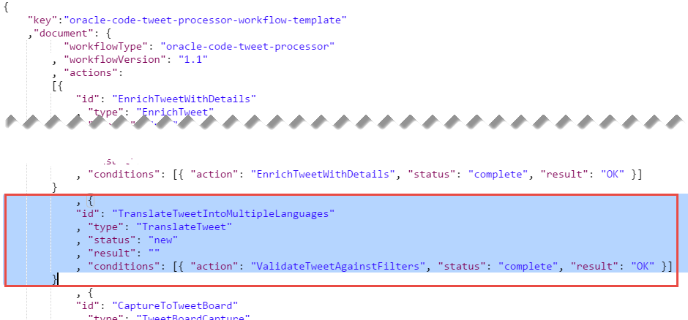
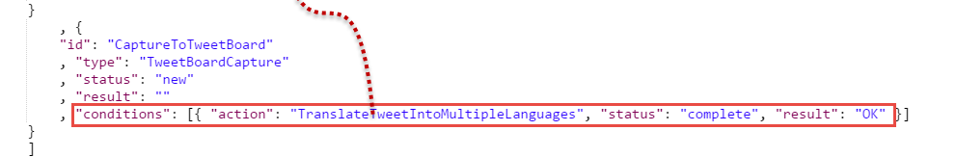
Modified workflow template
API
API
Translate Tweet
TweetBoard
UI
API

Slide 74
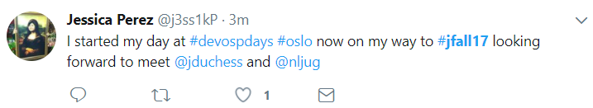
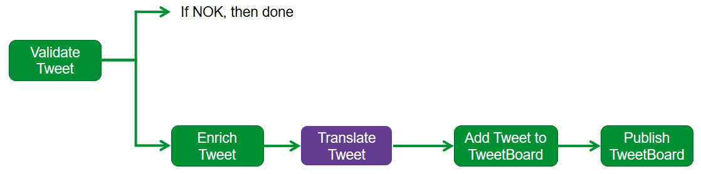
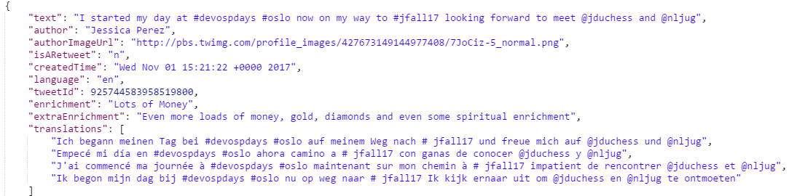
Result on tweet board including translation

Slide 75
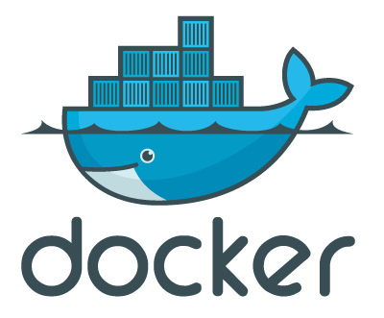
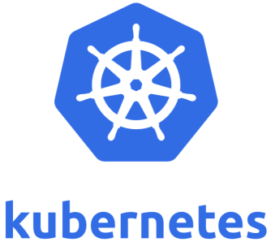
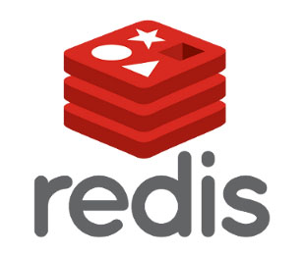
Main technical challenges
Network
Dockerize NodeJS applications
Run Docker container images in Kubernetes cluster
Pass environment variables and disk volumes
Expose services through ports
Create Replica Sets to manage availability & scaling
Link NodeJS applications in Kubernetes to Kafka Cluster in VirtualBox
Producing to and consuming from Topic
Leverage in-cloud cache from Kubernetes Pod members
Share workflow instance state across microservices
Instead: use local cache (Redis) in Kubernetes
Create two-way (n-way) EventBridge between local microservices and cloud(s)

Slide 76
Summary
Microservices are about rapid rollout of scalable, available functionality
(session) Stateless, Continuous deployment, horizontal scale out
One team is owner of a microservice and can evolve and deploy independently
Microservice is understandable and manageable
Microservices contain everything that is special for their implementation
External dependencies only on generic platform capabilities and public APIs
Microservices expose a public API
REST resources & operations and events (consumed and produced)
Decoupled, Event-based interaction is crucial for microservices
Cache synchronization, Monitoring, CQRS, Event Sourcing, Choreographed workflows
The microservices platform should provide an Event Bus capability
Apache Kafka is a proven, popular Event Bus implementation – available on premises and in the cloud

